Slide 1
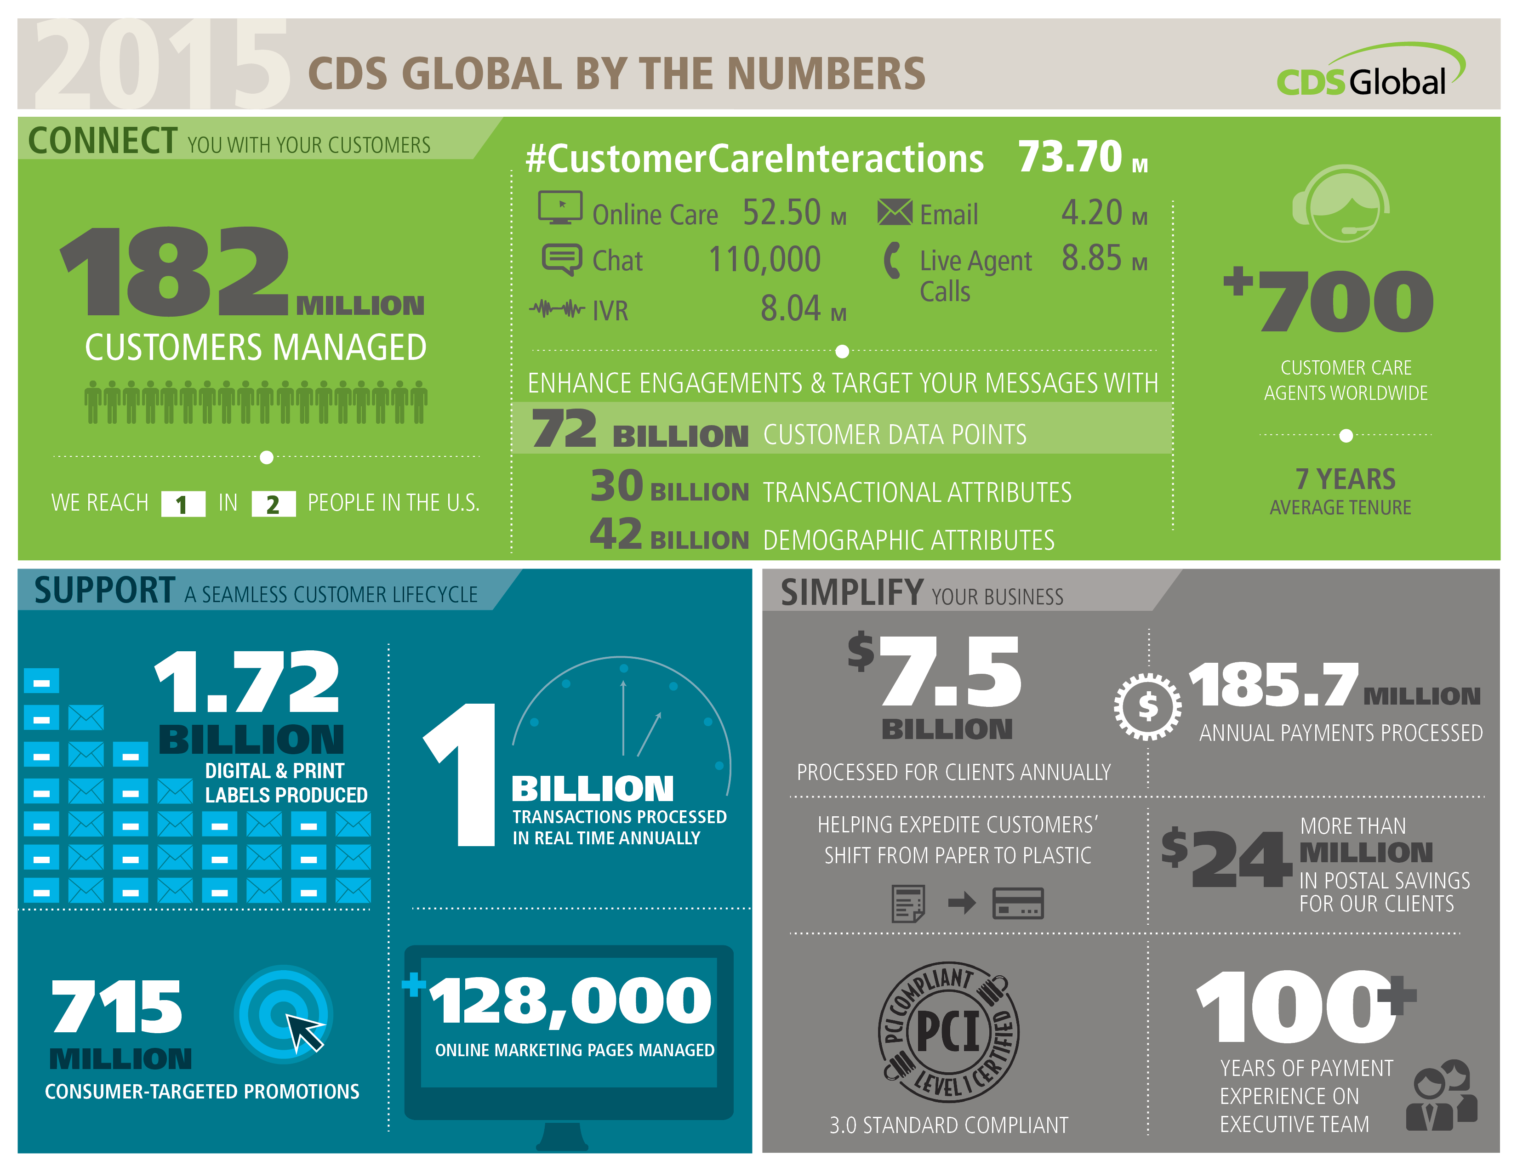
Notes:
2015 By the Numbers (This will be updated annually)
Notes: Figures are global. Unless notated, the figure represents a point in time. Example: The 100 industries represented by the executive team is as of 2.1.15.
CONNECT:
182 Million Customers: Total number of customers managed across all platforms across the globe.
73.7 million customer care interactions: Total of web log-ins, emails, IVR, chat and calls handled (broken out under figure). Annual figure
72 Billion customer data points: Number of pieces of data that we have on each customer on file.
700+ customer care agents with 7 years of tenure: Count and tenure across our global properties. The average does include UK & Canada staff tenure as well
SUPPORT:
1.72 billion digital + print labels produced: Number of labels produced by the Label selection teams and either printed or sent electronically. Annual figure – all of 2014.
1 Billion transactions processed in real-time: Number of transactions processed in real-time for magazine system, product system, DCS systems, Internet globally. Annual figure – all of 2014.
715 Million consumer targeted promotions: Total number of all mail pieces (promotions, acknowledgements, bills, renewals, etc) and all emails (promotional, acknowledgements, eTrans, eBills, eRenewals, etc). Annual figure – all of 2014.
128,000 online marketing pages managed: All web pages created, supported and maintained, globallay, for our clients across all industries
SIMPLIFY:
7.5 billion processed for clients annually: Amount of $ deposited by CDS Global for our clients globally. Annual figure – all of 2014.
185.7 million annual payments processed: Number of payments that were processed by CDS Global on behalf of our clients, offline and online
$24 million in postal savings: Amount of money we saved our clients with postal discounts (not include mail$save+)
PCI Level 1 compliant, following 3.0 standards: We are the first media fulfillment company to adopt the 3.0 standards, which is the most stringent level of compliance
100+ years of payments experience on the executive team: years of experience as of Feb. 1
[CLICK]

Slide 2
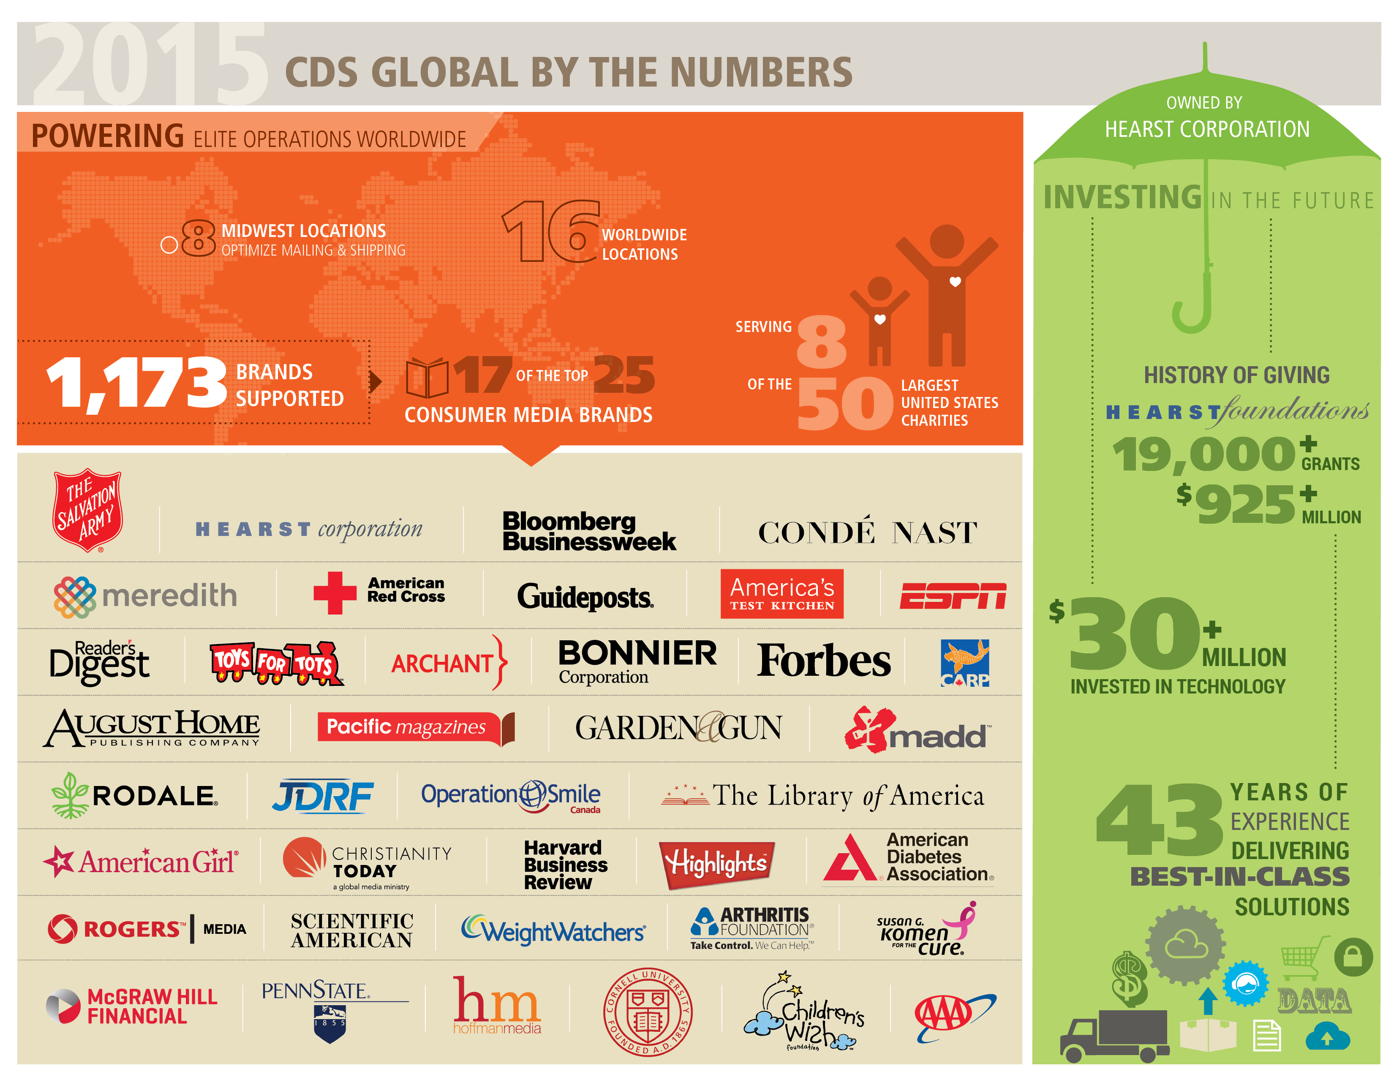
Notes:
2015 By the Numbers continued
POWERING:
8 Midwest locations: optimize mailing/shipping from midwest
16 Locations: All locations, globally.
1,173 Brands Supported: Total number of brands we work with at all locations. This does break out brands under a single owner, example Hearst is not counted once, but is the total number of titles they have.
Top 17 of 25 consumer media brands supported (publisher level, i.e. Hearst, Conde, etc)
Top 8 of 50 nonprofit brands supported (brand level, i.e. Red Cross, etc)
LOGOS:
Diverse set of brands to showcase our breadth and depth across various industries. These logos are all approved for external usage.
INVESTING:
Owned by Hearst: Important for non-media clients, for brand recognition and that we are not a “Johnny-come-lately” or “fly-by-night” provider.
Hearst foundations: History of giving through our organizations to showcase our companies support for non-profit foundations.
$30 million invested in tech: Showcase our commitment to technology and that we have the funds to continue our innovation
43 years of experience delivering best in class solutions: Showcases our experience as a business process outsourcer with over 40 years of experience. Our history is a testament that we expertly handle our client’s interactions with their customers.
[CLICK]

